Slide 1







Enterprise Blockchain Developers (Intermediate)
In support of
Powered By

Slide 2
Outline
Fallback Proxy
Docker
Docker Compose
Node js and Express js
© 2017-2020 SmartMesh Foundation Pte. Ltd. | MeshBox Foundation Pte. Ltd.

Slide 3
Docker Overview
What is Docker?
Docker is a tool designed to make it easier to create, deploy, and run applications by using containers.
Docker enables you to separate your applications from your infrastructure so you can deliver software quickly. With Docker, you can manage your infrastructure in the same ways you manage your applications
What does this mean?
mimic all the enviroment, systems in virtural container
we can run the applications in this virtural envirement
this container along with the preinstalled applications can be quickly deployed

Slide 4
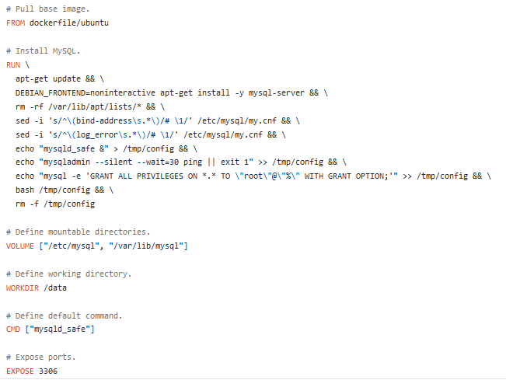
Docker File
Docker file
mysql Docker example: https://github.com/dockerfile/mysql/blob/master/Dockerfile

Slide 5
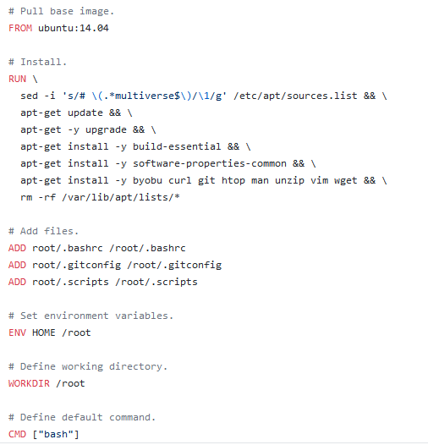
Docker File
Docker file
dockerfile/ubuntu: https://github.com/dockerfile/ubuntu/blob/master/Dockerfile

Slide 6
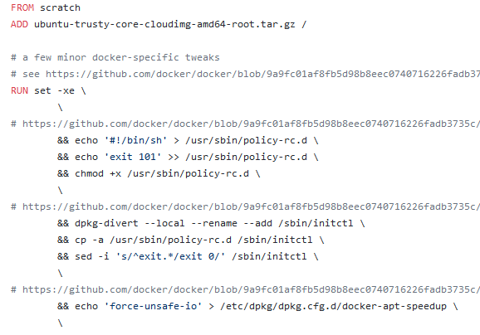
Docker File
Docker file
ubuntu:14.04: https://github.com/tianon/docker-brew-ubuntu-core/blob/ec931883d8292935b62ac40757287491e6ff467e/trusty/Dockerfile

Slide 7
Docker File
Now we come back and think about what the Docker is?
1. reproduce the all the enviroment setting up steps in the virtual container
2. either build it from the source or / upload the local built image to the docker hub for people download and use directly in their Docker file or docker-compose

Slide 8
Docker Command Explain
FROM：initializes a new build stage and sets the Base Image for subsequent instructions.
RUN：instruction will execute any commands in a new layer on top of the current image and commit the results
COPY: copies new files or directories from <src> and adds them to the filesystem of the container at the path
CMD provide defaults for an executing container. CMD executed when docker run; RUN exectued when docker build。
ENTRYPOINT: allows you to configure a container that will run as an executable.
ENV: sets the environment variable <key> to the value <value>
VOLUME: creates a mount point with the specified name and marks it as holding externally mounted volumes from native host or other containers
EXPOSE: expose ports
WORKDIR: sets the working directory

Slide 9

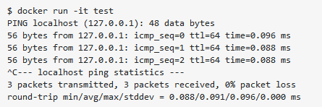
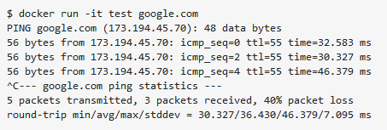
Docker Command Explain
CMD vs ENTRYPOINT
The ENTRYPOINT specifies a command that will always be executed when the container starts.
The CMD specifies arguments that will be fed to the ENTRYPOINT.
no argument
with the argument

Slide 10

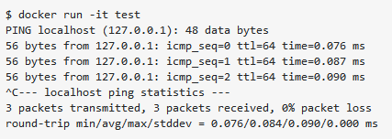

Docker Command Explain
CMD vs ENTRYPOINT
The ENTRYPOINT specifies a command that will always be executed when the container starts.
The CMD specifies arguments that will be fed to the ENTRYPOINT.
no argument
with the argument will override

Slide 11
Docker Compose Overview
What is Docker Compose?
Compose is a tool for defining and running multi-container Docker applications. With Compose, you use a YAML file to configure your application’s services. Then, with a single command, you create and start all the services from your configuration.
Explain the test network docker-compose yaml file
https://github.com/hyperledger/fabric-samples/blob/master/test-network/docker/docker-compose-test-net.yaml
Docker set the enviriment and the applications, docker-compose quickly deploy in the servers
peer node start + all the envirment variable = command line peer node start

Slide 12
Docker Demo
Command Demo
Dockerizing a Node.js web app

Slide 13
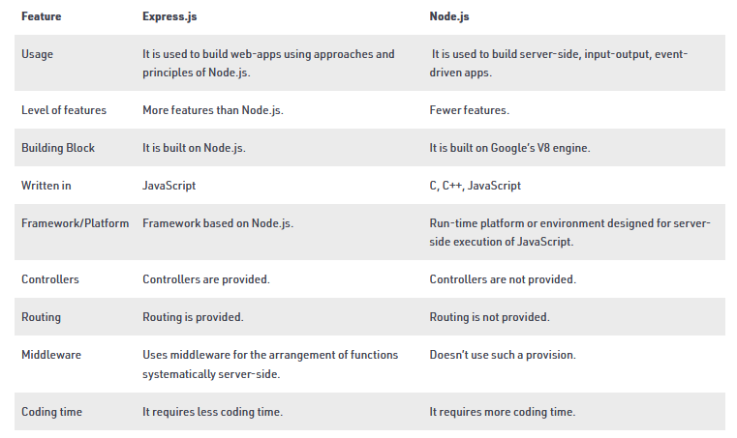
What are Node and Express js
Deffierence

Slide 14
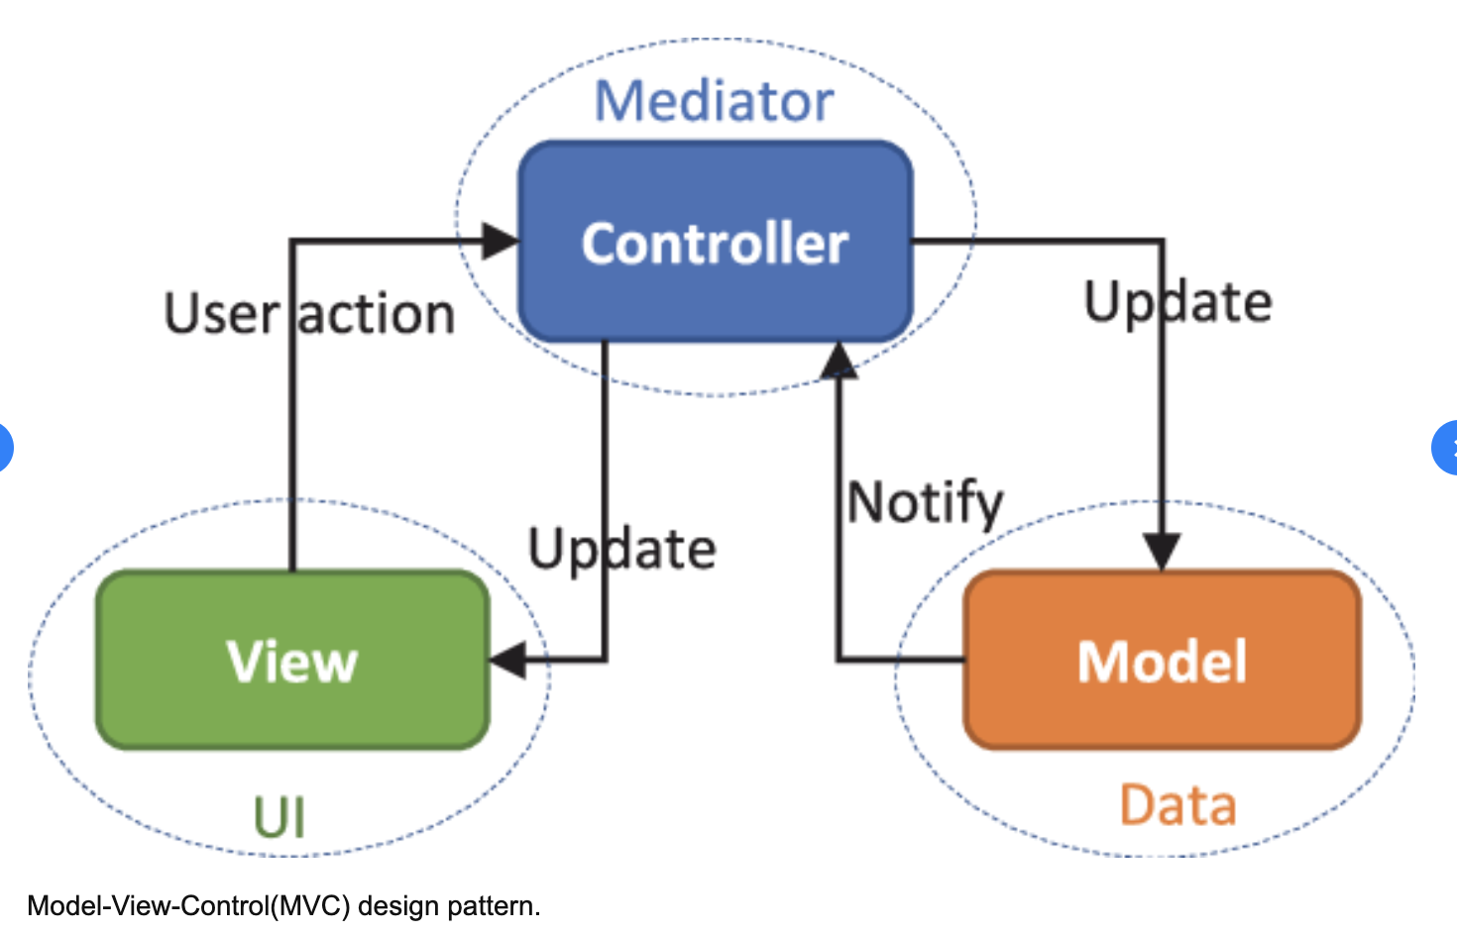
MVC Model
Model-View-Control

Slide 15
MVC Model
Model
The central component of the pattern. It is the application's dynamic data structure, independent of the user interface.[5] It directly manages the data, logic and rules of the application.
View
Any representation of information such as a chart, diagram or table. Multiple views of the same information are possible, such as a bar chart for management and a tabular view for accountants.
Controller
Accepts input and converts it to commands for the model or view

Slide 16
MVC Model
MVC Model Programming Steps: Node and Express js
Steps:
1. Setting up an Express App
2. Adding middleware
3. Setting up database connection
Iterating process:
3. Writing routes and controller
4. Defining corresponding data models
5. Writing corresponding html

Slide 17
SQL
Query:
Select * from table_name
Update:
INSERT INTO users (id, name, email, password, createdAt, updatedAt)
VALUES (3, "bing", "we@qq.com", "123","","");
Deletion:
DELETE from users WHERE name = "bing";
count, distinct, max, min, sum
select keyword() from users where xxx;
(code demo on database.sqlite)

Slide 18
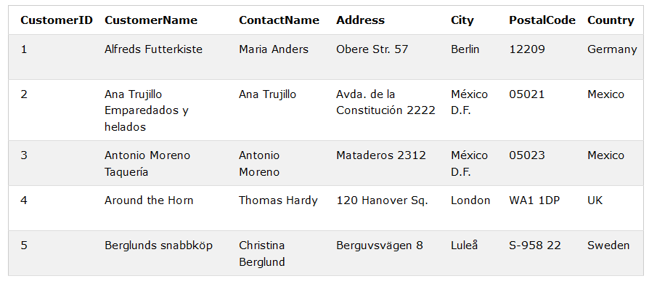
SQL
Ordering
SELECT column1, column2, ...
FROM table_name
ORDER BY column1, column2, ... ASC|DESC;

Slide 19
SQL
Grouping
SELECT column_name(s) / max(column_name)
FROM table_name
WHERE condition
GROUP BY column_name(s)
ORDER BY column_name(s);

Slide 20
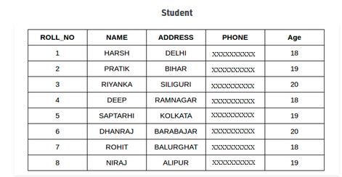
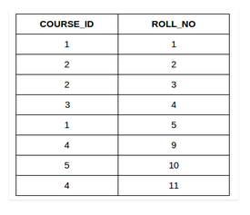
SQL
INNER JOIN, LEFT JOIN, RIGHT JOIN, FULL JOIN

Slide 21
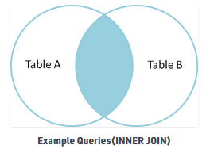
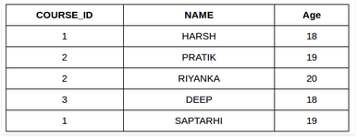
SQL
INNER JOIN
SELECT table1.column1,table1.column2,table2.column1,....
FROM table1
INNER JOIN table2
ON table1.matching_column = table2.matching_column;

Slide 22
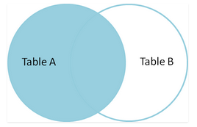
SQL
Left JOIN
SELECT table1.column1,table1.column2,table2.column1,....
FROM table1
LEFT JOIN table2
ON table1.matching_column = table2.matching_column;

Slide 23
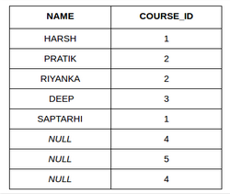
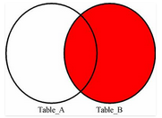
SQL
RIGHT JOIN
SELECT Student.NAME,StudentCourse.COURSE_ID
FROM Student
RIGHT JOIN StudentCourse
ON StudentCourse.ROLL_NO = Student.ROLL_NO;

Slide 24
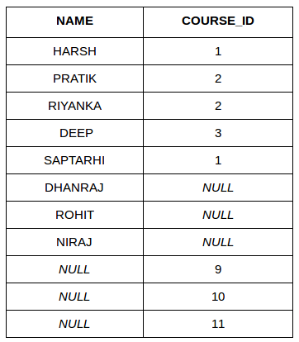
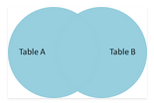
SQL
Full JOIN
SELECT Student.NAME,StudentCourse.COURSE_ID
FROM Student
FULL JOIN StudentCourse
ON StudentCourse.ROLL_NO = Student.ROLL_NO;

Slide 25
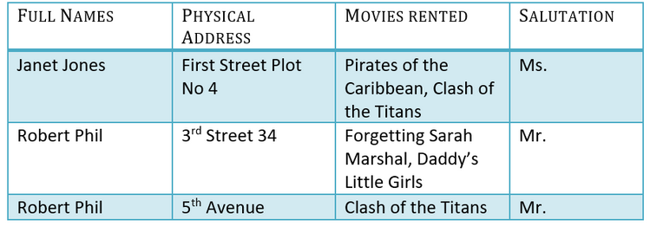
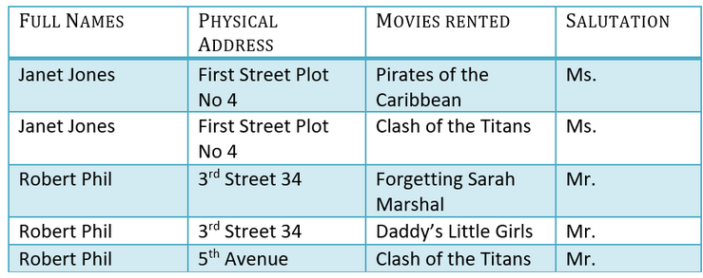
DataBase Design
1NF 2NF 3NF:
1NF: Each table cell should contain a single value.

Slide 26
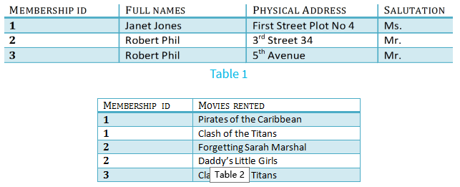
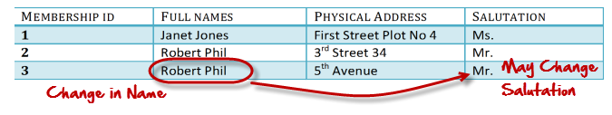
DataBase Design
2NF: Single Column Primary Key
3NF: Has no transitive functional dependencies
A transitive functional dependency is when changing a non-key column, might cause any of the other non-key columns to change

Slide 27
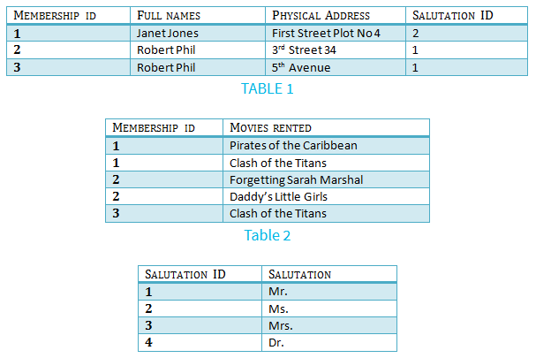
DataBase Design
3NF

Slide 28
MVC Code Demo Requirements: Registration
Requirements:
1. Design database models: Using SQLite3
2. Write Login, Logout, and Dashboard home page
3. Write controller to interact with database through Models and rendering views
Do Code Demo Later

Slide 29
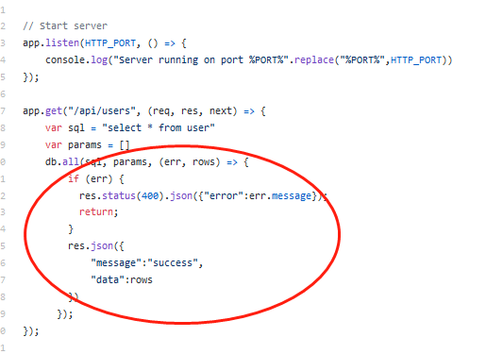
Problem Without Model
https://github.com/onebit256/node-express-rest-api-example (Explain the code)
Without using Model
If we want to change the data query logic, we have to change the controller's logic

Slide 30
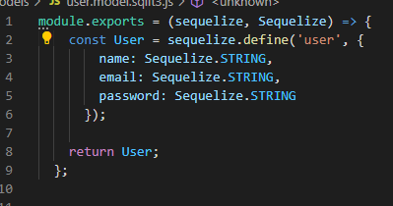
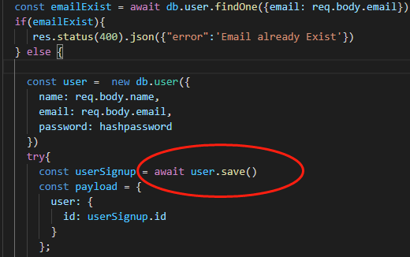
Problem Without Model
https://github.com/onebit256/node-express-react-demo-project (Explain the code) With Model
*
if we want to change the logic of
data save function, we don't neet to
change the controller's logic
program is more readable
easier to understand other's code

Slide 31
Sequelize
What is Sequelize ?
Sequelize is a promise-based ORM for Node.js v4 and upwards. It supports the dialects PostgreSQL, MySQL, SQLite and MSSQL and features solid transaction support, relations, read replication and more.
What is ORM ?
An ORM is known as Object Relational Mapper
ORMs save time in writing raw SQL queries thereby reducing development time.
out of box query
Example
select *from user => user.findAll()
select * from user where => user.find()

Slide 32
Request Type
Get Request (code demo)
the parameters are taken in url
Post Request(code demo)
the parameters are taken in request playload
demo Postman, project interaction

Slide 33
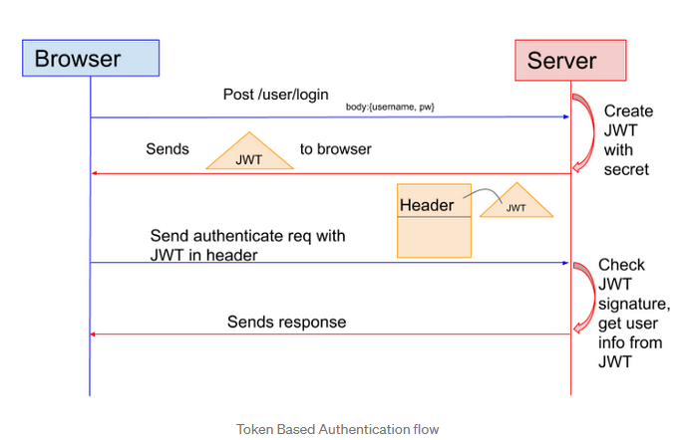
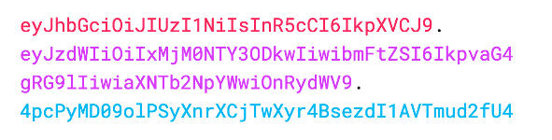
JsonWebToken(JWT)
What is JWT

Slide 34
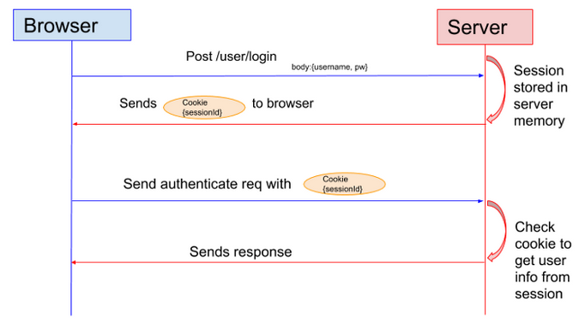
JsonWebToken(JWT)
JWT vs Session
Drawback: the Session cannot be verified cross servers for the cluster, unless stored in database

Slide 35
MVC Code Demo Requirements: Registration
Requirements:
1. Design database models: Using SQLite3
2. Write Login, Logout, and Dashboard home page
3. Write controller to interact with database through Models and rendering views
Code Demo Now
How to write a program from scratch

Slide 36
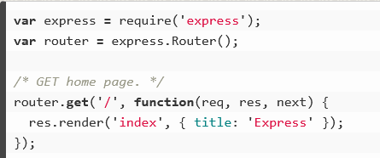
Send Parameters to the View
Code Demo
Compare a normal program with a api program

Slide 37
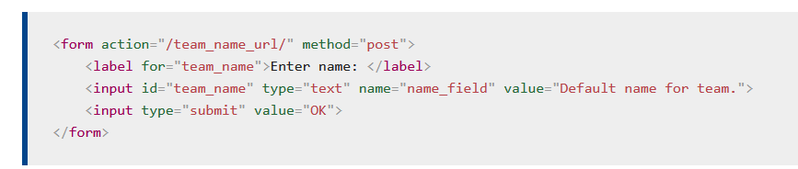
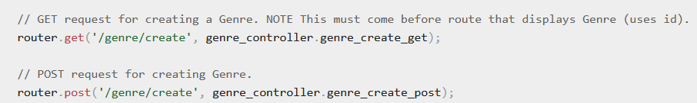
Form
1 specify Router
2 specify the request type, usually POST for Forms
Form will take inputs value as parameters to send to the server
action should match routes, then the route will call the controller function to handle the request. In this case, put action = /genre/create

Slide 38
File Upload
https://www.geeksforgeeks.org/file-uploading-in-node-js/

